Slide 1




FLORA
AI-Powered Agricultural Assistant
Faculty of Science — Helwan University
Statistics & Computer Science Department
Supervisor: Prof. Dr. Nadia Abdelsamea
TEAM MEMBERS
Khaled Fouad Ibrahim · Mohamed Sayed Saeed Ali · Youssef Mahdy Mohamed
Seif El Din Hamouda Kamel · Ahmed Walid Soliman · Shehab Eissa Abdel Monem

Slide 2

INTRODUCTION · THE CHALLENGE
The Problem
01
02
03
LATE DETECTION
NO EXPERT ACCESS
COMPLEX SOLUTIONS
Farmers struggle to identify plant diseases early, often noticing damage only after significant crop loss.
Agricultural specialists are scarce, expensive, and rarely available in rural farming communities.
Existing tools use technical jargon, require expensive hardware, or lack Arabic language support.
Wrong crop diagnosis destroys yields, livelihoods, and food security — FLORA was built to change that.
FLORA · Helwan University · Faculty of Science · Statistics & Computer Science

Slide 3
INTRODUCTION
What is FLORA?
An AI-powered plant disease detection and Arabic treatment guidance system
COMPUTER VISION
Detects plant diseases from leaf images using Deep Learning & CNN.
ARABIC AI CHATBOT
Provides intelligent treatment guidance in natural Arabic language.
REAL-TIME DIAGNOSIS
Upload a photo — get an instant AI-powered diagnosis.
FARMER FRIENDLY
Accessible interface built for everyday agricultural users.
CNN Image Classification
Conversational AI
Real-Time Diagnosis
Arabic NLP
FLORA · Helwan University · Faculty of Science · Statistics & Computer Science

Slide 4

INTRODUCTION · THE SOLUTION
How FLORA Solves It
A five-step intelligent pipeline from leaf photo to treatment plan
01
02
03
04
05
UPLOAD
ANALYZE
DETECT
EXPLAIN
TREAT
User uploads a plant leaf image
CNN model processes the image
Disease identified instantly
Chatbot explains the condition
Treatment plan provided
◆ Fast Diagnosis
◆ Easy Interaction
◆ Arabic Support
◆ User-Friendly
◆ Accessible
FLORA · Helwan University · Faculty of Science · Statistics & Computer Science

Slide 5
INTRODUCTION · SYSTEM ARCHITECTURE
System Architecture Overview
Three AI layers connected into one seamless real-world platform
USER
WEBSITE
CNN MODEL
CHATBOT
RESPONSE
Uploads Leaf
Image
Web
Interface
Disease
Detection
AI
Response
Arabic
Guidance
CNN Image Classification
Conversational AI Chatbot
Full Web Platform
Responsible for plant disease detection.
Responsible for Arabic AI communication.
Connects CNN and chatbot seamlessly.
FLORA · Helwan University · Faculty of Science · Statistics & Computer Science

Slide 6
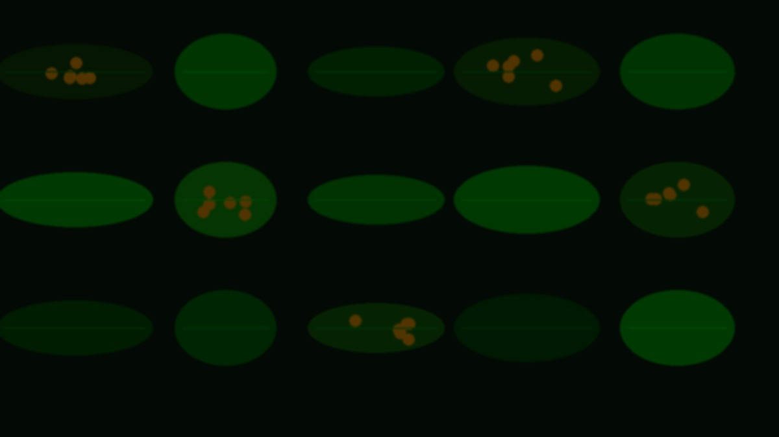
SECTION 01
CNN MODEL
DATA COLLECTION & PREPROCESSING
Building the visual intelligence behind FLORA.
FLORA — AI Agricultural Intelligence System

Slide 7
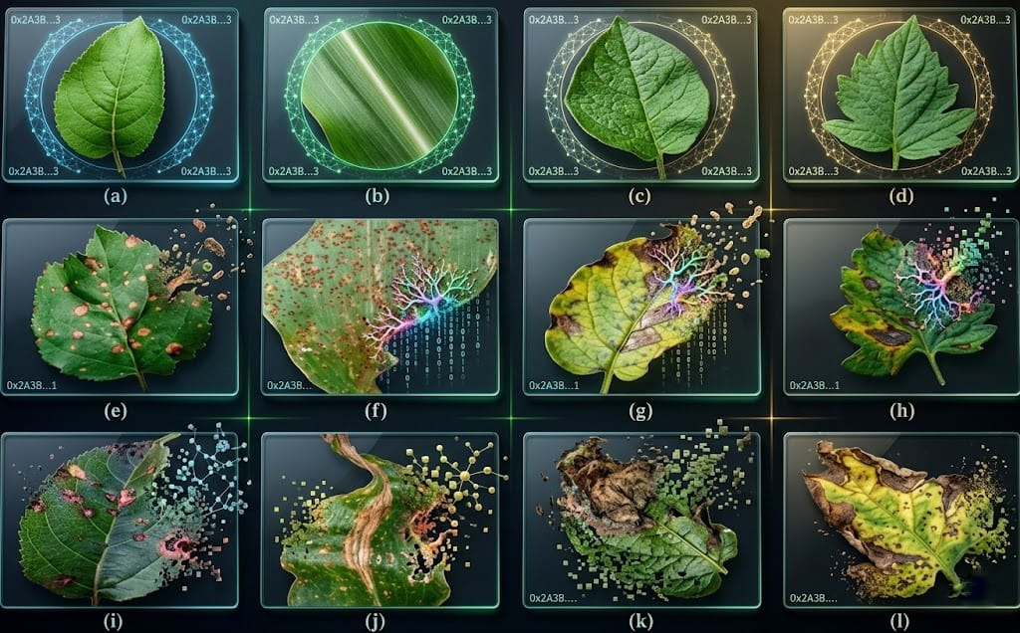
CNN MODEL · COMPUTER VISION
Why Computer Vision?
Plant diseases are fundamentally visual — machines can learn to see them too
VISUAL SYMPTOMS
Plant diseases appear visually — through leaf color, texture, spots, and patterns requiring image-based analysis.
BEYOND RULE SETS
Traditional rule-based systems fail to capture subtle visual variations between disease types and severity levels.
HUMAN-LIKE VISION
Deep Learning mimics how a trained agronomist visually identifies diseases — at scale and instantly.
REAL WORLD ROBUST
CV models handle lighting variation, image noise, overlapping leaves, and partial occlusion naturally.
FLORA · Helwan University · Faculty of Science · Statistics & Computer Science

Slide 8
CNN MODEL · DATA COLLECTION
Dataset Research Journey
Searching, evaluating, and selecting the optimal training dataset
SELECTED DATASET
1.
Searched and evaluated multiple agricultural image datasets
Multiple
Plant Species Categories
2.
Compared dataset quality, label consistency, and diversity
Multiple
3.
Tested coverage of real-world disease conditions
Disease Classification Classes
4.
Balanced
Analyzed class balance across disease categories
Healthy & Infected Samples
5.
Selected the most suitable and comprehensive dataset
Real-World
Agricultural Conditions
FLORA · Helwan University · Faculty of Science · Statistics & Computer Science

Slide 9
CNN MODEL · PREPROCESSING
Data Cleaning & Preparation
Building a reliable foundation — clean data defines model accuracy
STEP 01
STEP 02
STEP 03
STEP 04
Remove Corrupted
Organize Categories
Standardize Sizes
Quality Validation
Identified and removed all damaged, unreadable, or duplicate image files.
Structured dataset folders into consistent, class-labeled directories.
Resized all images to a uniform resolution for model input consistency.
Final integrity checks to ensure dataset quality before training begins.
Why It Matters
Clean, consistent data directly determines the accuracy and reliability of the trained AI model.
FLORA · Helwan University · Faculty of Science · Statistics & Computer Science

Slide 10
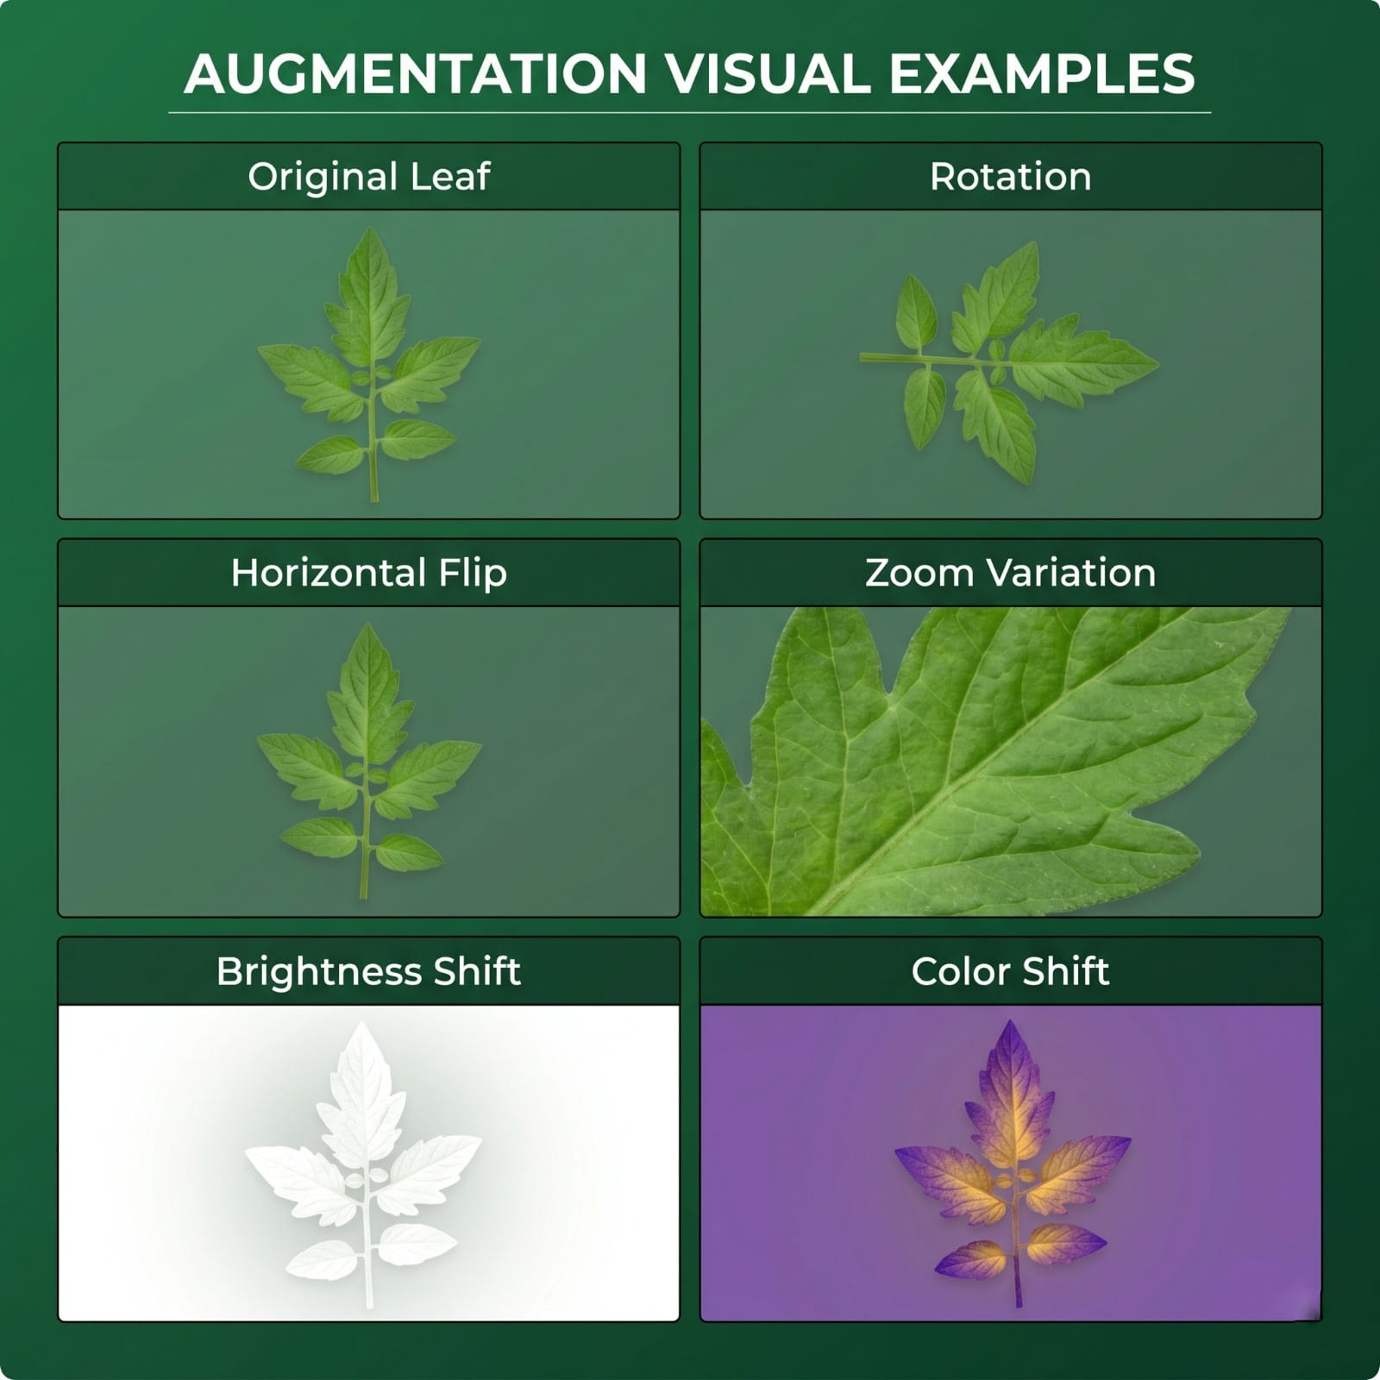
CNN MODEL · AUGMENTATION
Data Augmentation Techniques
Expanding dataset diversity to improve generalization and robustness
Rotation
Images rotated at multiple angles to simulate different capture orientations.
Horizontal Flip
Mirror images to instantly double effective training samples.
Zoom Variation
Random zoom levels simulate different camera-to-leaf distances.
WHY AUGMENTATION MATTERS
Prevents overfitting to training data
Brightness Shifts
Improves real-world generalization
Exposure adjustments replicate varied real-world lighting conditions.
Increases model robustness
Expands dataset artificially
FLORA · Helwan University · Faculty of Science · Statistics & Computer Science

Slide 11
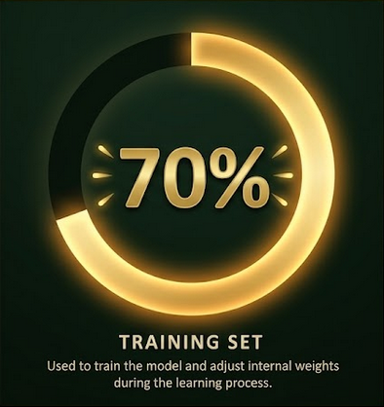
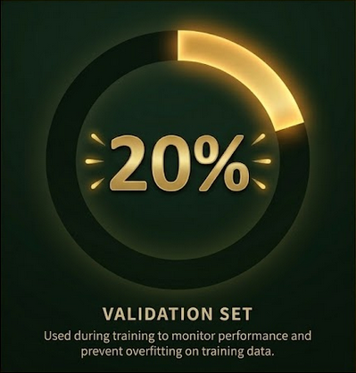
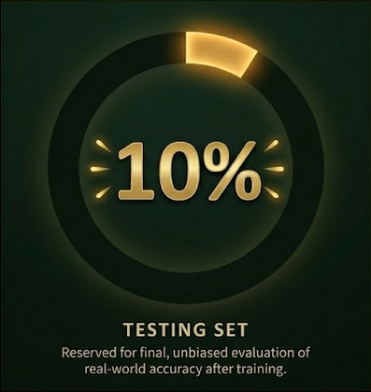
CNN MODEL · DATA SPLITTING
Dataset Splitting Strategy
Partitioning data to ensure fair, unbiased model evaluation
Why Splitting Matters:
Prevents overfitting
Enables fair evaluation
Validates real-world reliability
These three splits ensure the model learns effectively, evaluates honestly, and generalizes to real-world conditions.
FLORA · Helwan University · Faculty of Science · Statistics & Computer Science

Slide 12

SECTION 02
CNN MODEL
TRAINING & EVALUATION
Teaching AI to recognize plant diseases accurately.
FLORA — AI Agricultural Intelligence System

Slide 13
CNN MODEL · ARCHITECTURE CHOICE
Why Convolutional Neural Networks?
The architecture purpose-built for visual disease pattern recognition
INPUT
CONV
POOL
CONV
FC
OUTPUT
Leaf Image
Features
Reduction
Deeper
Classify
Disease
Pattern Recognition
Feature Extraction
Translation Invariance
CNNs automatically detect visual fingerprints — edges, textures, and patterns that define each disease.
Learns meaningful visual features hierarchically, from simple edges to complex disease signatures.
Recognizes diseases regardless of their position in the image — robust to real-world variation.
FLORA · Helwan University · Faculty of Science · Statistics & Computer Science

Slide 14
CNN MODEL · ARCHITECTURE
CNN Architecture Design
The complete layer pipeline from raw image to disease classification
INPUT
CONV 1
POOL 1
CONV 2
POOL 2
FLATTEN
FC LAYER
SOFTMAX
224×224
Image
Extract
Features
Spatial
Reduce
Deeper
Features
Spatial
Reduce
1D
Vector
Classify
Learn
Disease
Output
Convolution Layers
Pooling Layers
Fully Connected
Slide filters across the image to extract visual features like edges and textures.
Reduce spatial dimensions while preserving dominant features — faster & robust.
Final classification decisions based on all features learned by the network.
FLORA · Helwan University · Faculty of Science · Statistics & Computer Science

Slide 15
CNN MODEL · TRAINING
Model Training Process
Five iterative steps that transform raw data into a trained disease detector
1
Feed Data
Training images are fed in batches to the CNN model for processing.
KEY PARAMETERS
2
Forward Pass
Model makes predictions using its current weight configuration.
Optimizer:
Adam
Loss Function:
Categorical Crossentropy
3
Calculate Loss
Measures the difference between the model's predictions and true labels.
Learning Rate:
Adaptive scheduling
4
Backpropagation
Adjusts internal weights to minimize prediction errors over time.
Batch Size:
Mini-batch gradient descent
Epochs:
Multiple training iterations
5
Repeat Epochs
The entire process repeats until model accuracy converges to optimal.
FLORA · Helwan University · Faculty of Science · Statistics & Computer Science

Slide 16
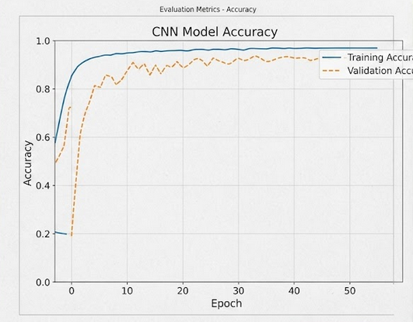
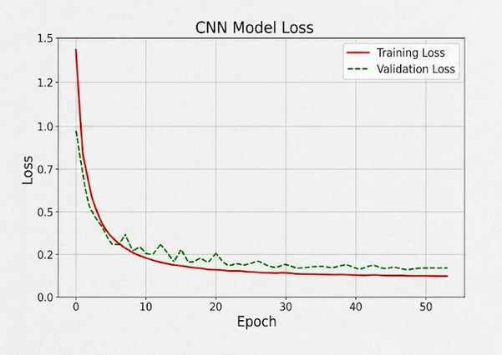
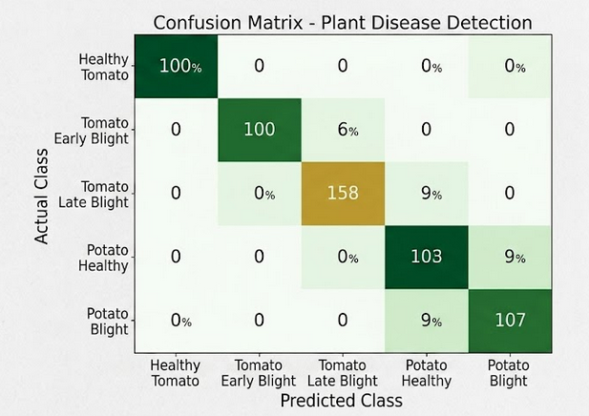
CNN MODEL · EVALUATION
Model Evaluation & Results
Visual performance metrics — accuracy, loss, and per-class predictions
Training Accuracy · Validation Accuracy
Training Loss · Validation Loss
Per-Class Prediction Performance
Accuracy
Precision
Recall
Overall % of correct predictions across all disease classes
Correctness rate per individual disease class
Disease detection completeness — minimizing missed cases
FLORA · Helwan University · Faculty of Science · Statistics & Computer Science

Slide 17
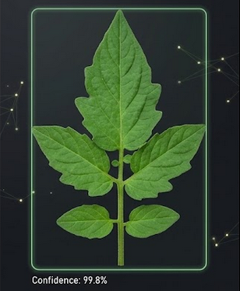
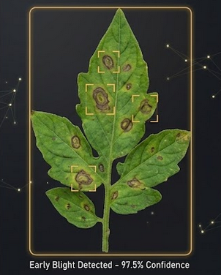
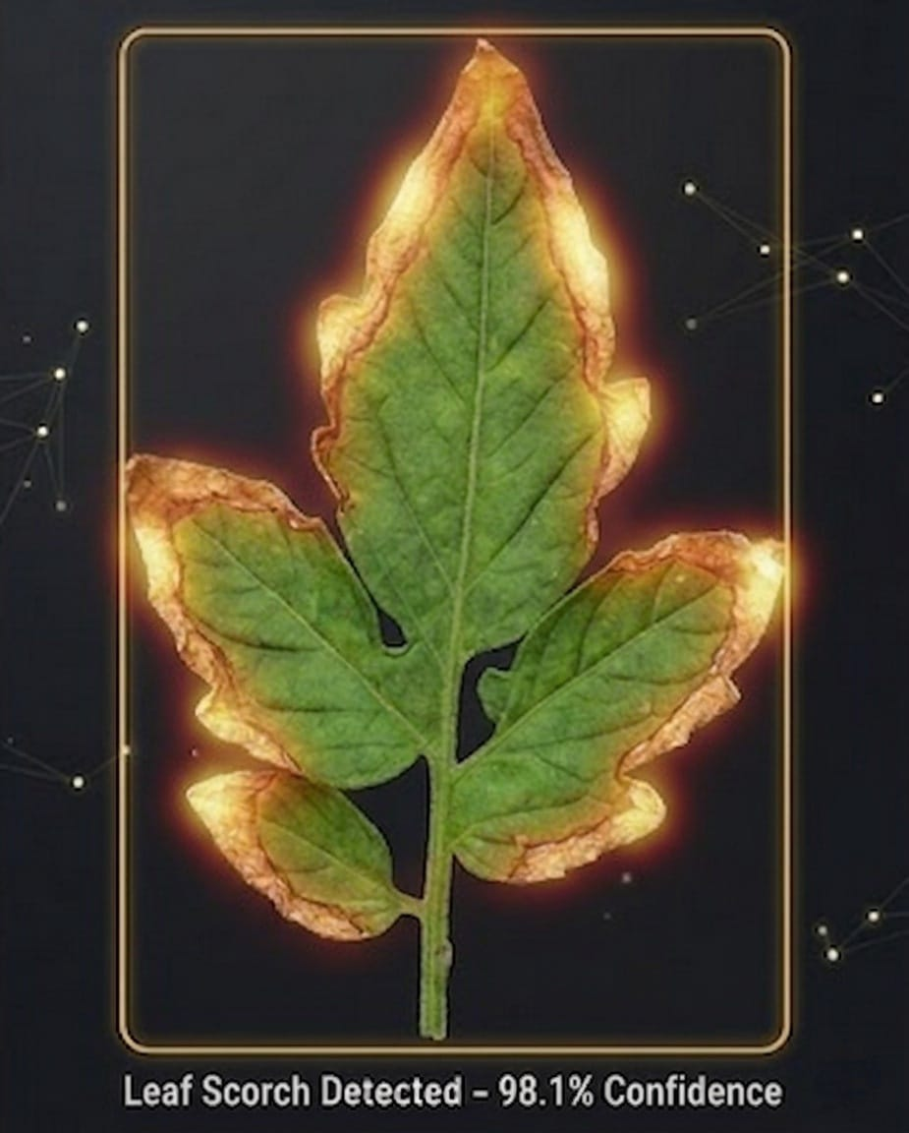
CNN MODEL · PREDICTIONS
Real Prediction Results
Live inference examples — the model classifying unseen leaf images
Healthy Leaf
Early Blight
Leaf Scorch
Predicted: Healthy ✓
Predicted: Early Blight ✓
Predicted: Leaf Scorch ✓
FLORA · Helwan University · Faculty of Science · Statistics & Computer Science

Slide 18
SECTION 03
CONVERSATIONAL AI
& CHATBOT SYSTEM
Transforming AI predictions into natural human interaction.
FLORA — AI Agricultural Intelligence System

Slide 19
CHATBOT SYSTEM · INITIAL CONCEPT
The Initial Chatbot Vision
The team's plan to build conversational AI from scratch using classical NLP techniques.
Intent Recognition
Why This Was Challenging
Understanding what the user is communicating from natural language input.
Massive NLP training datasets required
Response Mapping
Enormous computational resources needed
Matching detected intents to pre-defined conversational responses.
Very long development timeline
Pattern Matching
Identifying conversational patterns from collected training data.
Arabic + Egyptian dialect complexity
Language Modeling
Multi-turn conversation context handling
Teaching the system natural language understanding and generation.
FLORA · Helwan University · Faculty of Science · Statistics & Computer Science

Slide 20
CHATBOT SYSTEM · RESEARCH
Exploring AI Frameworks
Evaluating Rasa and Ollama before selecting the optimal solution
RASA
OLLAMA
Open-Source NLP Framework
Local Large Language Models
INITIALLY EXCLUDED
INITIALLY SELECTED
Full training control
Runs fully offline
Custom intent system
Privacy-preserving
Self-hosted solution
Large model support
Requires large NLP data
Initially selected for testing
After testing Ollama, performance limitations in Arabic language support prompted the team to explore further alternatives.
FLORA · Helwan University · Faculty of Science · Statistics & Computer Science

Slide 21
CHATBOT SYSTEM · FINAL CHOICE
Why We Chose Google Gemma 4
The model that transformed FLORA's conversational quality completely
Superior Response Quality
Arabic & Dialect Support
GEMMA 4
Generates more natural, contextually accurate conversational responses.
Understands Modern Standard Arabic and Egyptian dialect nuances.
by Google DeepMind
Serving as the cognitive core of FLORA Gemma 4 bridges the gap between complex AI diagnostics and practical farming advice Its advanced reasoning capabilities provide an intelligent, reliable, and highly accessible agricultural consultant.
Faster Response Times
Contextual Understanding
Optimized inference delivers near-instant responses to user queries.
Maintains meaningful conversation context across multiple turns.
Resource Efficiency
Actionable Advice
Lightweight architecture enables smooth deployment within our system
Translates complex diagnostics into clear treatment steps
FLORA · Helwan University · Faculty of Science · Statistics & Computer Science

Slide 22
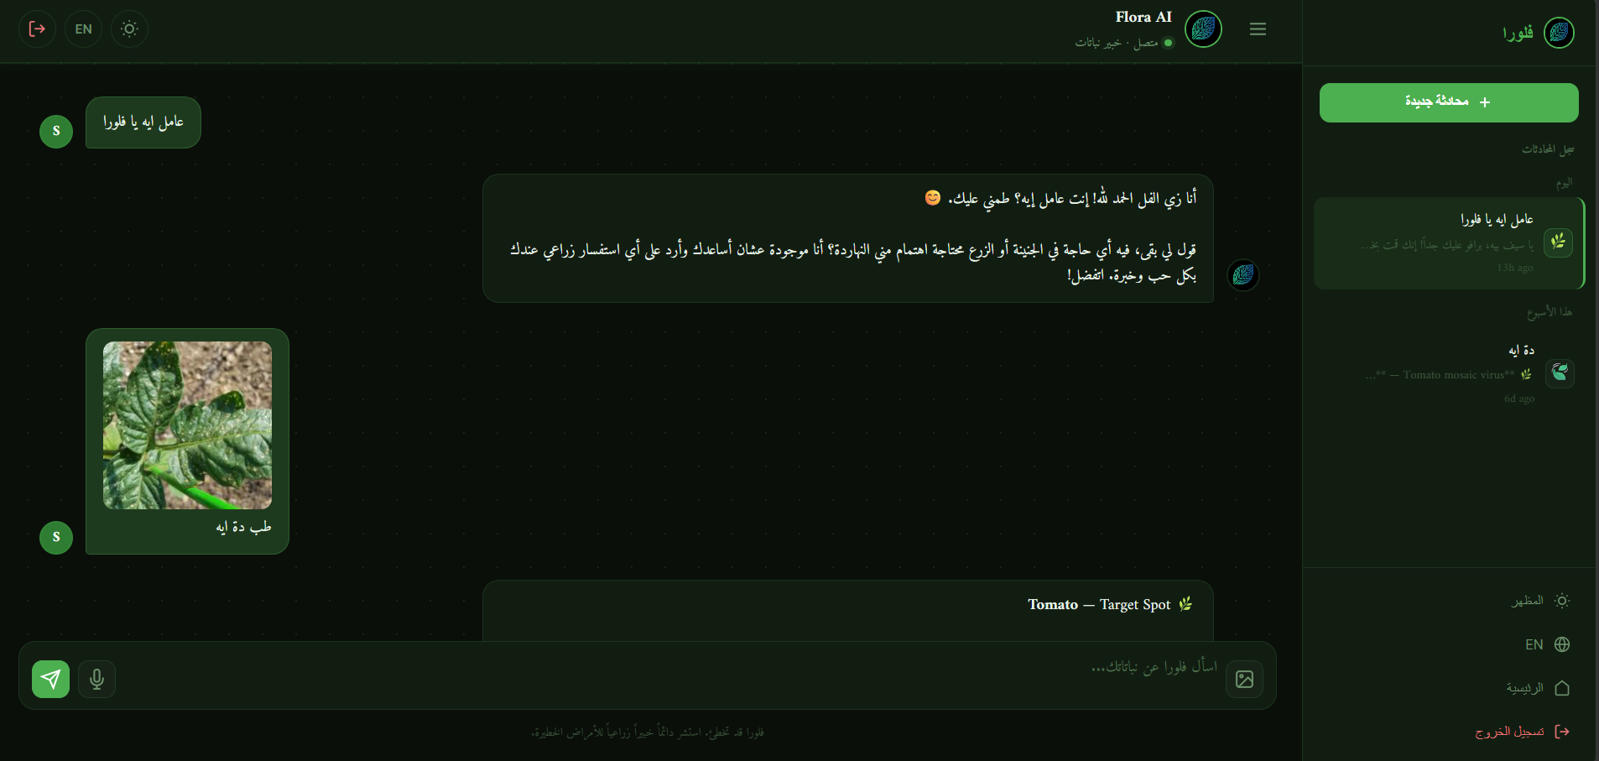
CHATBOT SYSTEM · TREATMENT GUIDANCE
Treatment Guidance System
A four-stage pipeline from disease detection to follow-up support
01
Disease Detection
CNN model identifies the plant disease from the uploaded leaf image.
02
Arabic Explanation
Chatbot explains the disease clearly in simple, accessible Arabic.
03
Treatment Plan
Step-by-step treatment recommendations provided to the user.
04
Follow-up Support
Users ask follow-up questions and receive continued guidance.
FLORA · Helwan University · Faculty of Science · Statistics & Computer Science

Slide 23

SECTION 04
WEB PLATFORM
& USER EXPERIENCE
Connecting all AI systems into a seamless real-world application.
FLORA — AI Agricultural Intelligence System

Slide 24
WEB PLATFORM · FEATURES
Website Features & Authentication
A secure, complete platform connecting every FLORA capability
Homepage
Professional landing page introducing FLORA with a clean interface.
User Registration
Secure signup with full form validation and user account creation.
Email Verification
Mandatory email confirmation for security — no unverified access.
Login System
JWT-based authentication ensuring protected, secure user sessions.
Forgot Password
Full password recovery flow via secure email link verification.
FLORA · Helwan University · Faculty of Science · Statistics & Computer Science

Slide 25
WEB PLATFORM · DEMONSTRATION
Website Navigation & Authentication Demo
Full platform walkthrough — live from the running application
FLORA · Helwan University · Faculty of Science · Statistics & Computer Science

Slide 26

SECTION 05
USER INTERACTION
& CHAT EXPERIENCE
Exploring how users interact with FLORA in real time.
FLORA — AI Agricultural Intelligence System

Slide 27
USER EXPERIENCE · INTERACTION WORKFLOW
User Interaction Workflow
Six steps from image capture to continued AI-powered guidance
1
Upload Image
2
AI Analysis
3
Disease Result
User uploads a plant leaf photo to FLORA
CNN model processes and classifies the image
Diagnosis is displayed clearly to the user
4
Chat Opens
5
Treatment
6
Follow-up
Chatbot introduces and explains the condition
Step-by-step Arabic treatment guidance provided
User asks additional questions for further help
FLORA · Helwan University · Faculty of Science · Statistics & Computer Science

Slide 28
USER EXPERIENCE · LIVE DEMONSTRATION
FLORA Chatbot Live Demonstration
Full end-to-end demonstration — upload, detect, chat, treat
FLORA · Helwan University · Faculty of Science · Statistics & Computer Science

Slide 29
THANK YOU
We Are Ready For Your Questions
F L O R A
Faculty of Science — Helwan University · Statistics & Computer Science Department
Supervisor: Prof. Dr. Nadia Abdelsamea

